Slide 1
Understanding Business Communication

Slide 2
Understanding Business Communication
Components of Communication
Communication Barriers
Communication Media Choices
Legal and Ethical Communication

Slide 3
Understanding Business Communication
Components of Communication
Communication Barriers
Communication Media Choices
Legal and Ethical Communication

Slide 4
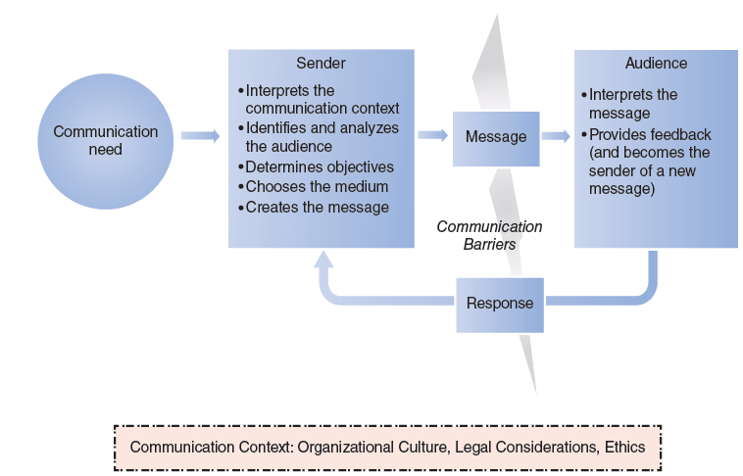
Communication Model
Components | Barriers | Media | Ethics

Slide 5
Directions of Formal Communication
Downward Communication
Flow of information from managers to their employees (people who report to them)
Lateral (or Horizontal) Communication
Flow of information among peers within an organization
Upward Communication
Flow of information from lower-level employees to upper-level employees or managers
Components | Barriers | Media | Ethics

Slide 6
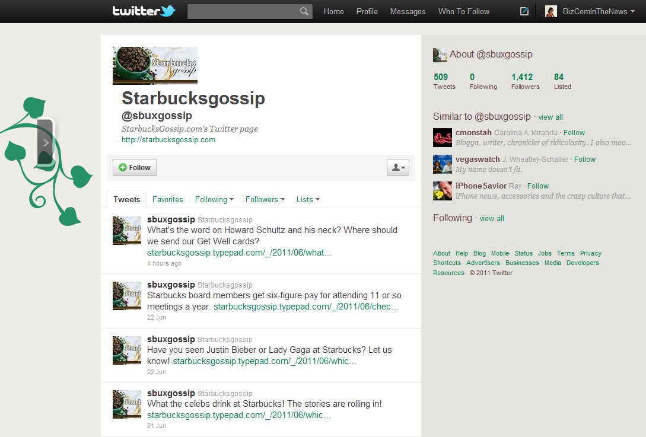
The Informal Communication Network
Components | Barriers | Media | Ethics

Slide 7
The Grapevine
“I’ve discovered that the less I say, the more rumors I start.”
- Bobby Clarke, Philadelphia Flyers hockey player
Why do you think this may be true?
As a manager, you can never stop the grapevine, but how can you manage it and learn from it?
WAVEBREAKMEDIA LTD/ISTOCKPHOTO.COM
Components | Barriers | Media | Ethics

Slide 8
Understanding Business Communication
Components of Communication
Communication Barriers
Communication Media Choices
Legal and Ethical Communication

Slide 9
Verbal Communication Barriers
Inadequate Knowledge or Vocabulary
Language Differences
Inappropriate Use of Expressions
Overabstraction and Ambiguity
Polarization
Differences in Interpretation
Components | Barriers | Media | Ethics

Slide 10
Do You Know These Terms?
Term
Definition
Search Engine Optimization: improving the visibility of websites in search engines
Joint Photographic Experts Group: a compression technique for color images
Retweet
Sending tweets that others wrote on Twitter
SEO
JPEG
A quick fix for a programming defect
Patch
Voice over Internet Protocol: used for making Internet phone calls
VoIP
Components | Barriers | Media | Ethics

Slide 11
Nonverbal Communication Barriers
Inappropriate or Conflicting Signals
Inappropriate Emotions
Distractions
Differences in Perception
Components | Barriers | Media | Ethics

Slide 12
Understanding Business Communication
Components of Communication
Communication Barriers
Communication Media Choices
Legal and Ethical Communication

Slide 13
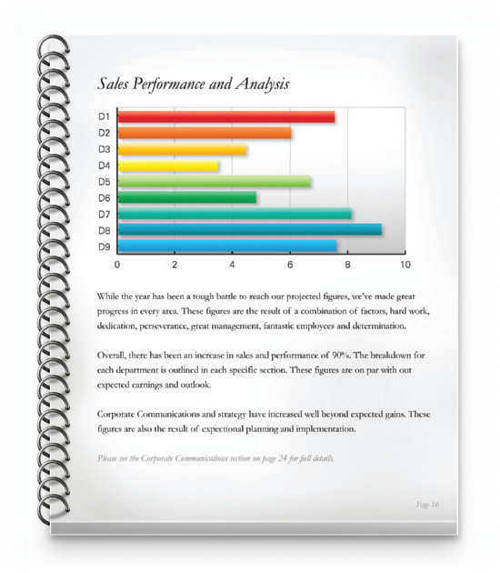
Traditional Communication Channels
Written Communication Examples
Colorful brochures
Financial statements
Solicitation letters
Complex reports
Periodicals (magazines, journals, newspapers)
Oral Communication Examples
One-on-one meetings
Team meetings
Conferences
© ISTOCKPHOTO.COM/SPIFF Y J5
ROBERT DALY/JUPITER IMAGES
Components | Barriers | Media | Ethics

Slide 14
Technology-Based Communication Channels
Email, Phone, Voice Mail
Instant and Text Messaging
Social Media
PIUS LEE/SHUTTERSTOCK.COM
BRIANAJACKSON/ISTOCKPHOTO.COM
DAVID J. GREEN - LIFESTYLE THEMES/ALAMY LIMITED
Components | Barriers | Media | Ethics

Slide 15
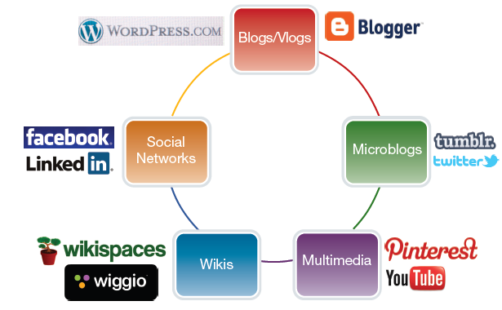
Social Media Examples
Components | Barriers | Media | Ethics

Slide 16
Communication Media Choices
Teleconferencing
Phone Call
Voice Message
Brochure
Newsletter
Flier
Face-to-Face Meeting
Blog
Microblog
IM
Videoconferencing
RICH LEAN
Online Meeting
Video
Vlog
Report
Email
In-Person Oral Presentation
Text Message
Components | Barriers | Media | Ethics

Slide 17
Choosing Communication Media
Relationship Considerations
New or existing relationship?
Good news or bad?
Feedback needed?
Audience level and preference?
Likely audience reaction?
Confidential message?
Documentation needed?
Logistical Considerations
Length and complexity of the message?
Number and location of recipients?
Urgency of the message?
Probability of audience understanding?
Access to technology?
How do these factors affect the medium you choose for your message?
Components | Barriers | Media | Ethics

Slide 18
Understanding Business Communication
Components of Communication
Communication Barriers
Communication Media Choices
Legal and Ethical Communication

Slide 19
Avoid Legal Consequences
If you delete an email, isn’t it gone forever?
© STOCKLITE/SHUTTERSTOCK
Avoid writing or saying anything that you would not like to become public.
Read your company’s social media policy carefully.
Components | Barriers | Media | Ethics

Slide 20
Types of Ethics
Professional Ethics
Social Ethics
Individual Ethics
Defined by an organization
Defined by society
Defined by a person
Components | Barriers | Media | Ethics

Slide 21
Lawyers’ Email Exchange
Did the lawyers behave professionally and ethically?
Who should have ended the conversation? When?
ALBERTO ZORNETTA/SHUTTERSTOCK.COM
Connect to the email exchange via the blog.
Components | Barriers | Media | Ethics
Notes:
You’ll find the entire email exchange as a PPT presentation on the blog www.bizcominthenews.com under Company Samples for Chapter 1.

Slide 22
Ethical Decision Making
1. Is the action legal?
2. Does the action comply with your company’s policies and guidelines?
3. Who will be affected by your decision and how?
4. Does the action comply with company values?
5. How will you feel after the decision is known?
Components | Barriers | Media | Ethics

